Slide 1
Detecting Cracks in Concrete Structures Using Adaptive Thresholding for Image Segmentation
Caleb Yearsley
CS 6680
Final Project

Slide 2
Desired Outcomes
Desired Outcomes
Related Methods
Proposed Approach
Shortcomings
My Improvements
Summary
Future Work
Desired Outcomes:
“Improved Simplified Novel Method for Edge Detection in Grayscale Images Using Adaptive Thresholding”
Improve the simplified adaptive thresholding technique
Expand on the adaptive thresholding technique, such that it works well with detecting cracks in concrete structures

Slide 3
Related Methods (categories)
Desired Outcomes
Related Methods
Proposed Approach
Shortcomings
My Improvements
Summary
Future Work
The adaptive thresholding technique is related to gradient operators (e.g Prewitt or Sobel)
Is a first order derivative of the gradient operator
Adaptive thresholding is based on similarity detection

Slide 4
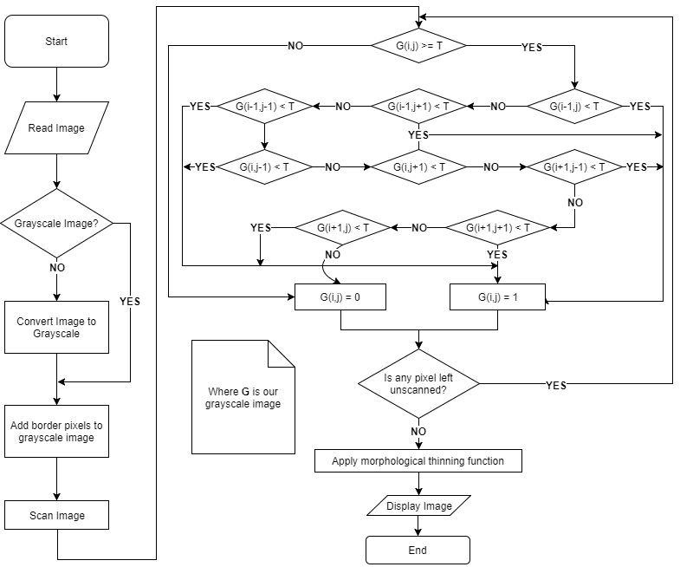
The Proposed Approach
Desired Outcomes
Related Methods
Proposed Approach
Shortcomings
My Improvements
Summary
Future Work
The proposed method uses a 3x3 mask.
Authors state that this method reduces the amount of noise.

Slide 5
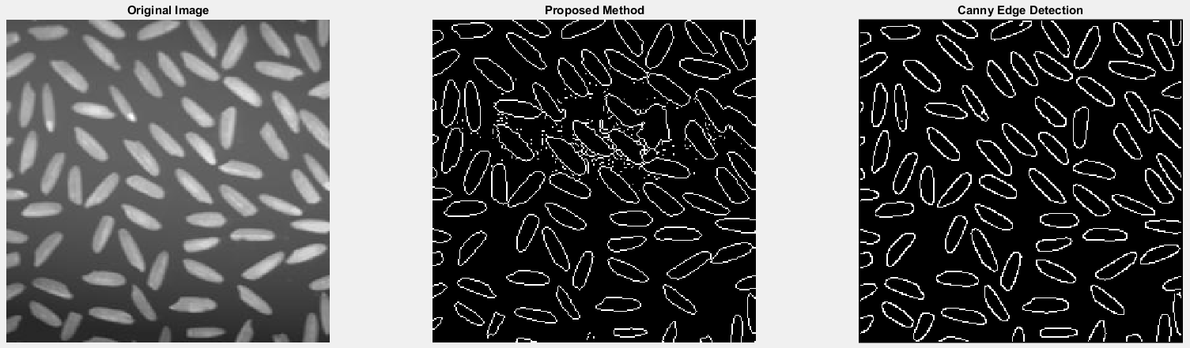
Method Comparison

Slide 6
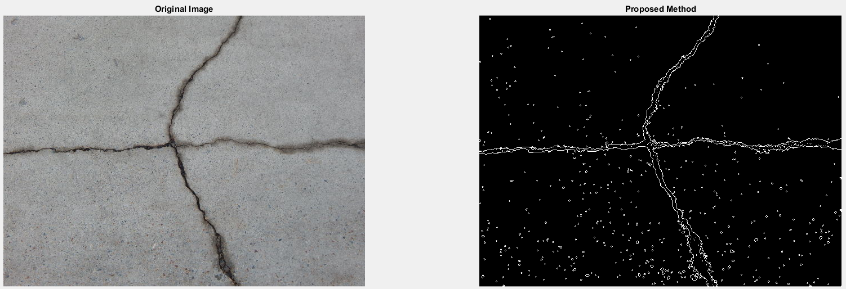
Shortcomings of Proposed Method
Desired Outcomes
Related Methods
Proposed Approach
Shortcomings
My Improvements
Summary
Future Work
Can produce noisy results (depending on the scenario)
Documented workflow is messy
Image segmentation isn’t always accurate

Slide 7
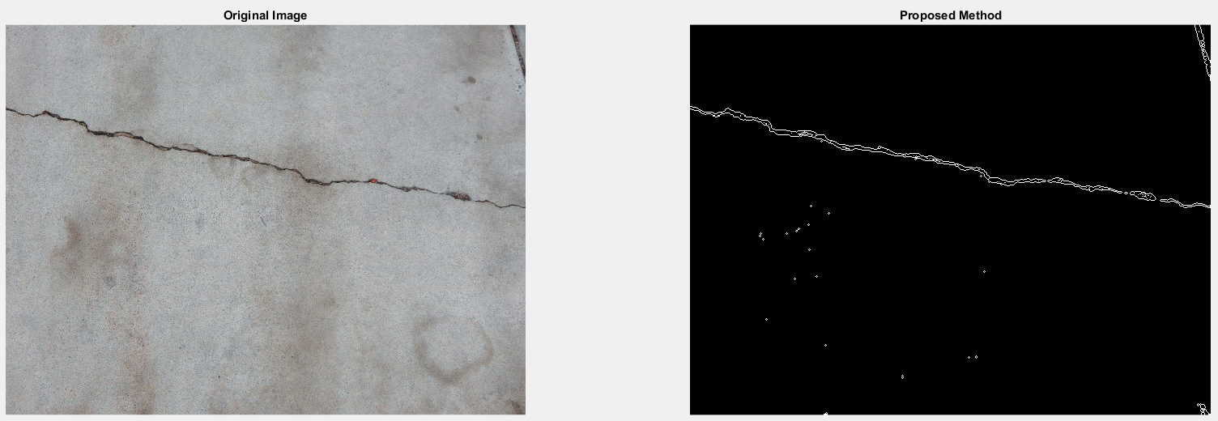
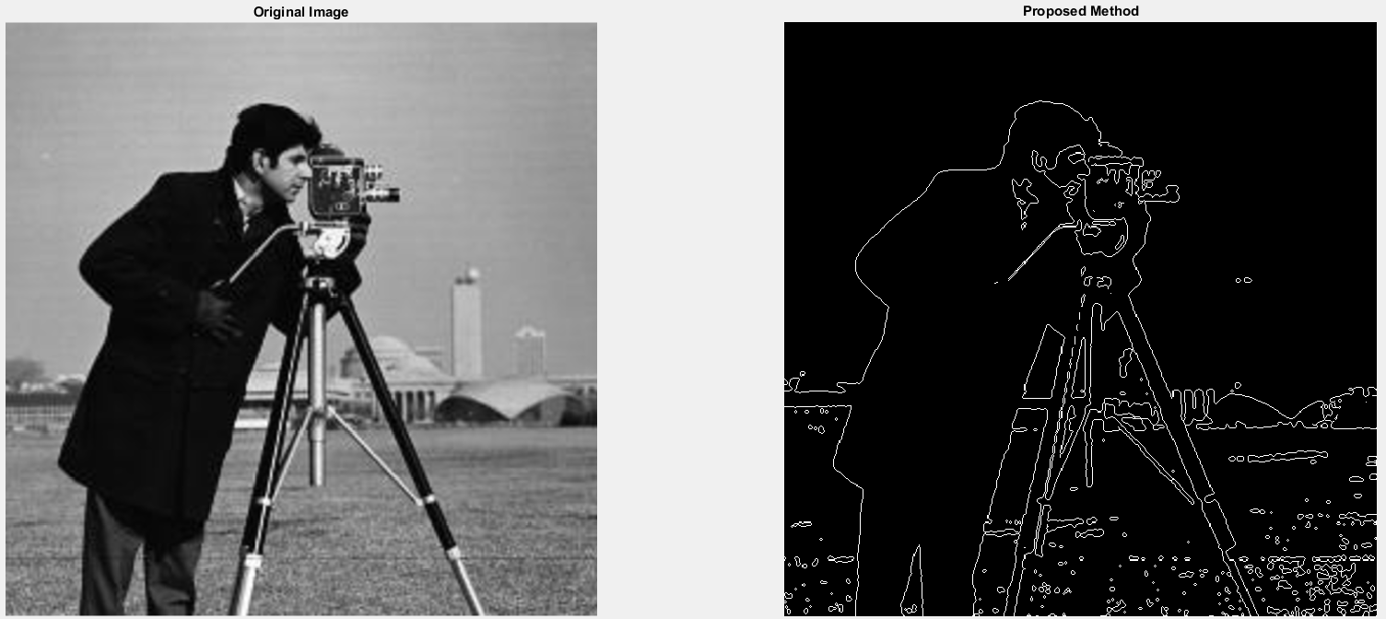
Shortcomings of Proposed Method (continued)
Desired Outcomes
Related Methods
Proposed Approach
Shortcomings
My Improvements
Summary
Future Work

Slide 8
My Improvements on the proposed approach
Desired Outcomes
Related Methods
Proposed Approach
Shortcomings
My Improvements
Summary
Future Work
Instead of using a 3x3 mask, I used a 5x5 mask
Along with using a morphological thin function, I also implemented:
Morphological clean function
Morphologically eroded the image
Morphologically dilated the image
Then removed excess pixels
Attempts to detect concrete regions
*assumes the primary focus of the image is the concrete structure
*assumes limited obstruction to the concrete structure

Slide 9
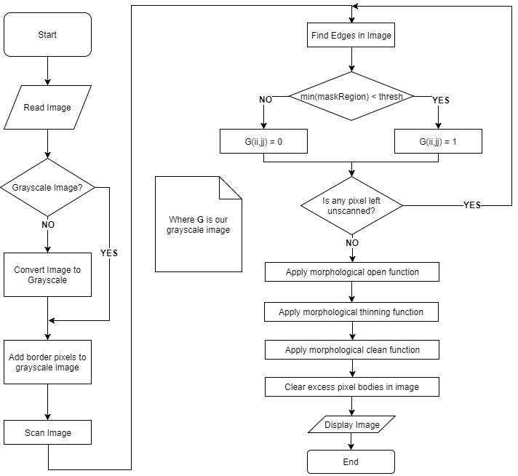
My Improvements on the proposed approach
Desired Outcomes
Related Methods
Proposed Approach
Shortcomings
My Improvements
Summary
Future Work
Improved method
uses a 5x5 mask
Actually does clean
up noise…

Slide 10
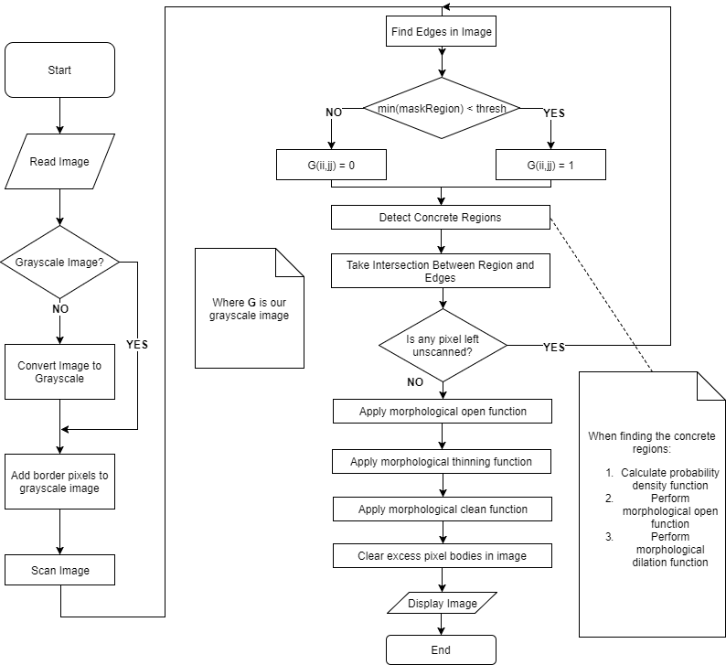
My Improvements on the proposed approach (continued)
Proposed Method Execution Time:
~ 0.003534 seconds
Improved Proposed Method Execution Time:
~ 0.041107 seconds
Improved method
uses a 5x5 mask
Actually does clean
up noise…

Slide 11
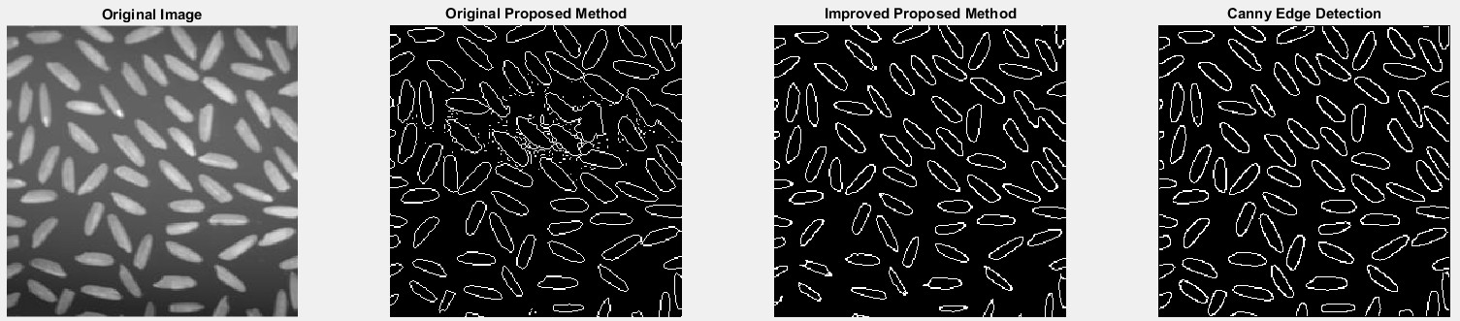
My Improvements on the proposed approach (continued)

Slide 12
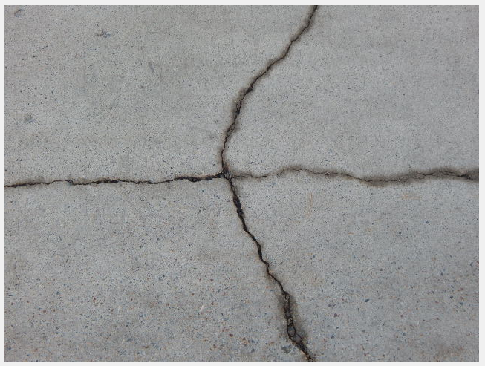
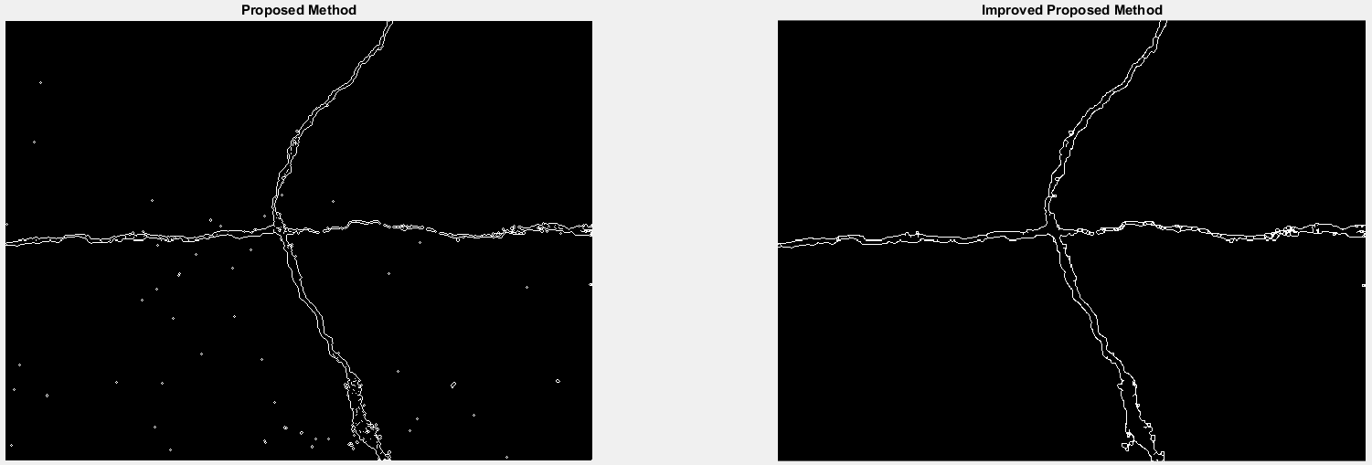
My Improvements on the proposed approach (continued)

Slide 13
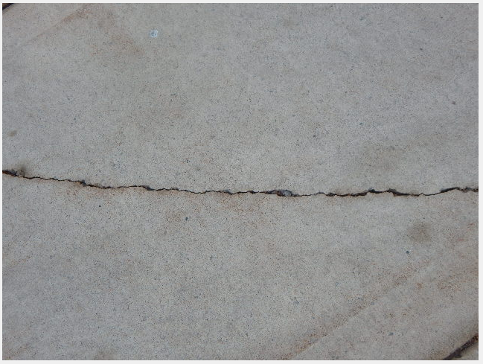
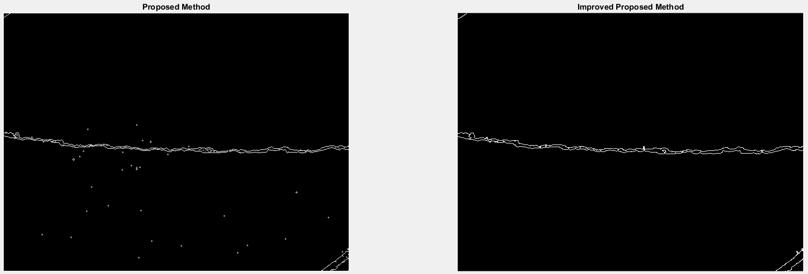
My Improvements on the proposed approach (continued)

Slide 14
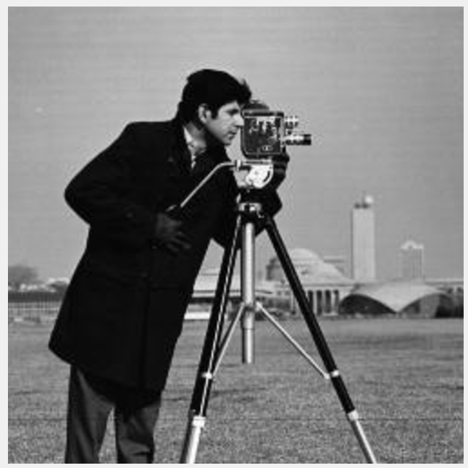
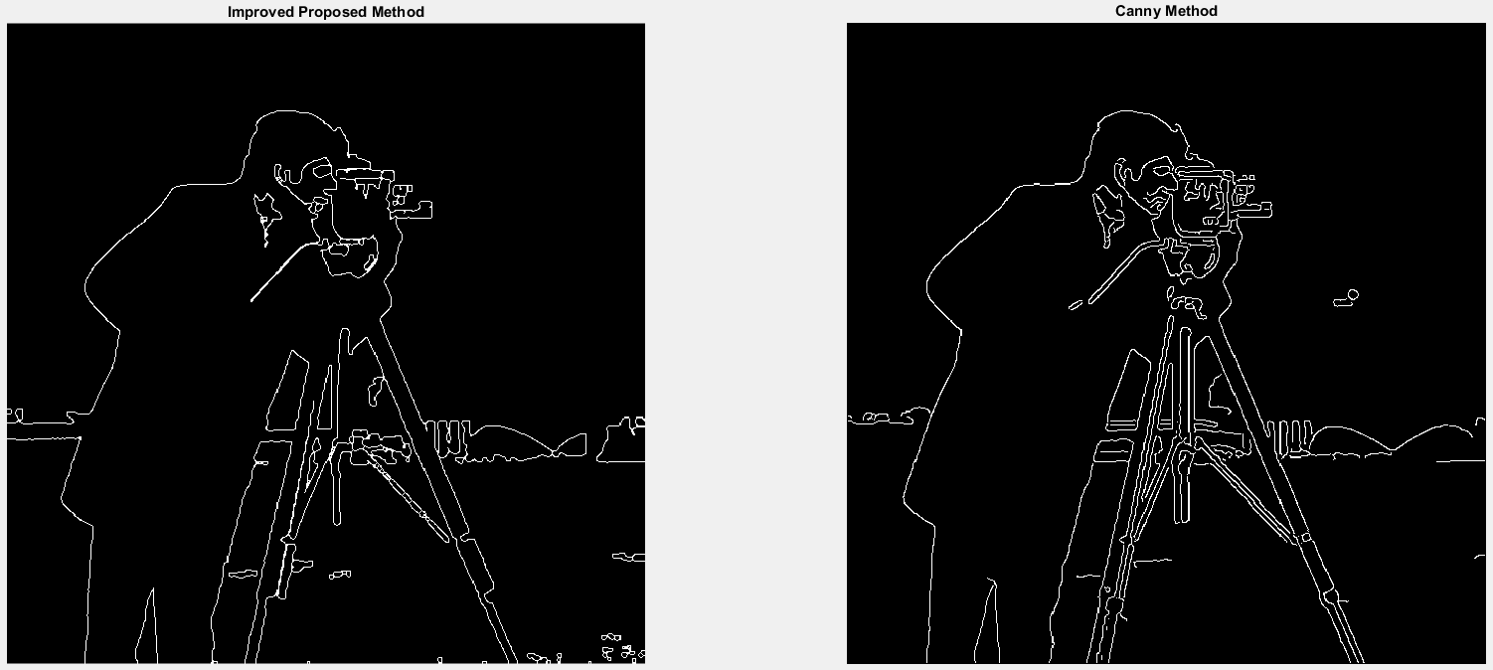
My Improvements on the proposed approach (continued)

Slide 15
Summary
Desired Outcomes
Related Methods
Proposed Approach
Shortcomings
My Improvements
Summary
Future Work
Success!
Improved image quality of the original proposed method
Improved workflow
Works well defined concrete structures
Doesn’t Take too long to process
Comparable to the Canny edge detection method

Slide 16
Potential Future work
Desired Outcomes
Related Methods
Proposed Approach
Shortcomings
My Improvements
Summary
Future Work
Complete process in a more timely manner
Continue to improve the system for concrete structures
Handle obstructions better
Handle discontinuities better

